Slide 1
About Java

Slide 2
Contents
Java Introduction
History of Java
Why Java
JVM
JRE
JDK
How Java Works
Installing Java
Simple Java Program
Setup Java
Installing Your application to other machines

Slide 3
Java Introduction
Java Introduction:
Java is Widely used Object-Oriented Programming Language.
It was created In 1995 by James Gosling.
It was created by Sun Micro System and now owned by Oracle.
One of the most significant advantages of Java is it’s ability to move easily from one computer system to another.
It is used to build Android Apps.

Slide 4
History of Java
Java History:
Sun Microsystem asked their programming team to come up with an name.
They saw a tall tree outside their office window and submitted ‘Oak’.
Unfortunately a search revealed that a company named Oak Technologies had already trademarked that name for a language used by their semiconductor chips.
The sun Microsystems development teams brainstormed and submitted ten new names.
Three passed the trademark test : Java, DNA, Silk.
The name chosen to replace Oak was Java.
Java has become most popular programming Language in the World.

Slide 5
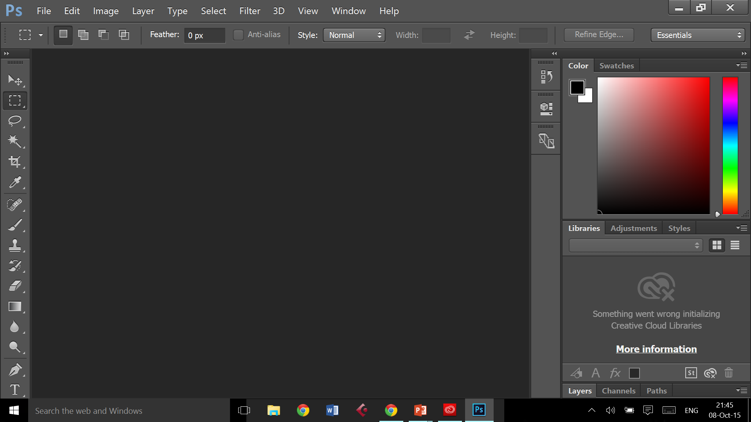
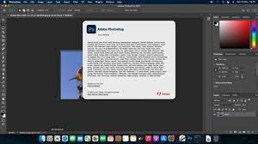
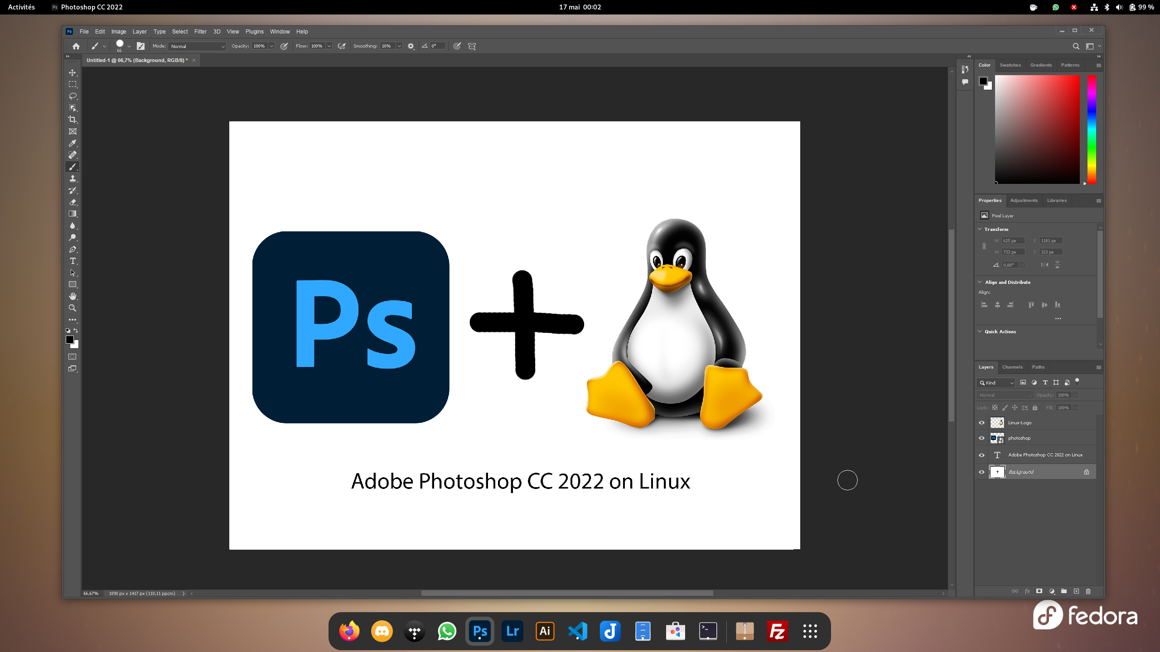
Why Java
Why Java:
Java is easy to learn
Java is Platform independent
So An code written in one platform can be copied and used in any other platforms.
Windows: Macos: Linux:

Slide 6
JVM
JVM:
JVM Stands for Java Virtual Machine.
It is a specification that provides runtime environment in which java bytecode can be executed.
JVM is available for many hardware and software platforms.
The JVM Performs following operations:
    Loads Code
    Verifies Code
    Executes Code
    Provides runtime environment

Slide 7
JRE
JRE:
JRE Stands for Java Runtime Environment.
It is a freely available software distribution which has Java Class Library, Specific Tools and a Stand – alone JVM.
To run an application developed in java we need JVM.
To get JVM we need to install JRE first.

Slide 8
JDK
JDK:
JDK Stands for Java Development Kit.
The JDK is a software development environment which is used to develop Java Application and Applets.
The JDK Contains private JVM( Java Virtual Machine ).
Few other resources such as:
Interpreter/Loader ( java )
Compiler ( javac )
Archiver( jar )
Documentation Generator ( Javadoc )

Slide 9
How Java Works
How java Works:
For most of the programing languages, a program is compiled into a machine language. Then the machine language program can be executed.
Java works in the same way, compiling source code into bytecode first.
The java virtual machine can then compile the bytecode into machine code.
The JVM Allows Java’s bytecode to execute on any device, which is why it’s known as a “ Write once, run anywhere ” language.

Slide 10

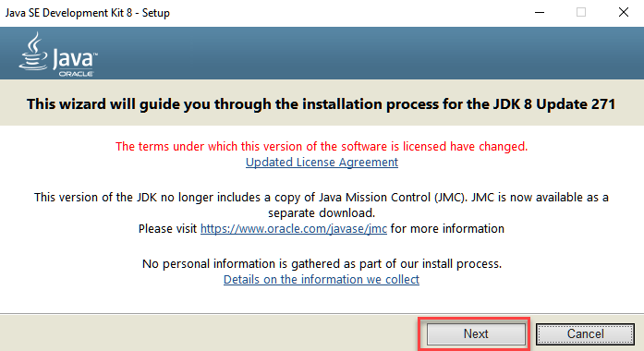
Install Java
Install Java:
Download Java 8 JDK from oracle server.
Once the download is completed, run the exe file to install JDK.

Slide 11
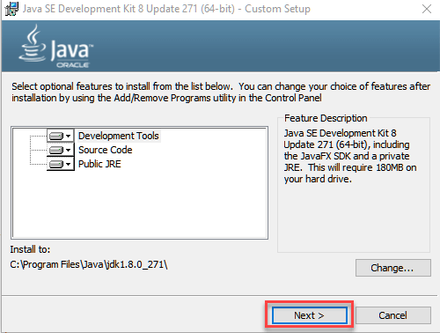
Install Java
Install Java:
Select the path to install java in windows and click next.
Once your installation is completed click close.

Slide 12
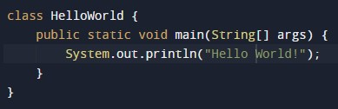

Simple java program
Simple Program:
Output:

Slide 13
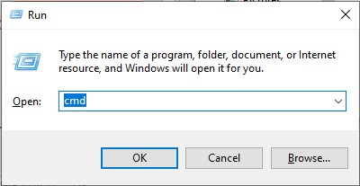


Setup Java
Setup Java:
Open command prompt:
Change to Java program file directory:
Set path to JDK file bin:
Compile the java file:

Slide 14

Setup Java
Setup Java:
After Compilation An class file is created by JVM:
Run the program by calling the class name:

Slide 15
Installing Application
Installing Application to Other Machines:
  After creating an java application we must install it to client machines.
  For that we don’t need the source code, instead we need only the class file which is created after compilation.
  We must paste the class file in client system.
  The JVM will access the byte code in class file and Executes the application.
  For that we don’t need to install JDK, installing JRE is enough.
  Because JRE comes with JVM.

Slide 16
Thank you

